Slide 1
Introduction to High School Admissions
Pablo Casals Middle School 181X
Notes:
Resources to give out:
2020 High School Admissions Guide
2020 Specialized High School Student Handbook
Summer and/or Fall Events Flyers (available in the resources folder. Go to school.myschools.nyc and click the link under “High School Admissions Resources”)

Slide 2
My Contact Information
Neferteria Dante
Guidance Counselor
Ndante@schools.nyc.gov
www.181guidance.weebly.com

Slide 3
Borough High School Fairs and Open Houses
This year each school will be holding their own virtual open house and tours for prospective applicants.
To get more information on a particular school, please visit:
https://www.schools.nyc.gov/enrollment/enroll-grade-by-grade/high-school

Slide 4
TACHS Exam & Catholic Schools
If your child has registered for the exam, you will have a page entitled “Applicant Record” which must be given to me.
It lists the 3 schools your child wishes to apply to and I send your child’s records to the school.
Deadline to register is October 23 , 2020
www.tachsinfo.com OR 1-866-618-2247
Results for Catholic schools are released in late January/early February

Slide 5
We will talk about…
High School Admissions Overview and Timeline
The Specialized High Schools
The High School Directory and Admissions Guide
Exploring Schools and Programs
Creating an Account Online
Welcome Letters
Next Steps
schools.nyc.gov/High
Notes:
Read bullets.

Slide 6
English Language Learners (ELL)
Students who are English Language Learners may apply to any high school in New York City.
All high schools must provide ELL services for students.
There are three different ELL service delivery models offered in NYC public high schools.
ELL students are eligible for supports and accommodations on admissions-related tests and auditions.
TIP
There are programs designed to serve students who are learning English. These programs admit students according to home language, years in the country, or English proficiency.
Notes:
Before we get into details, let’s cover a few things.
Read bullets.

Slide 7
Students with Disabilities (SWD)
Students with Individualized Education Programs (IEPs) may apply to any high school program in New York City; all high schools must provide services for students.
On each school page, you can find each program’s SWD seat availability last year, and each school’s accessibility category.
For High School Admissions, seats at each high school program are divided into two groups:
General Education (GE) seats | Students with Disabilities (SWD) seats
For students who receive general education instructional programming For students who receive special education instructional programming for 20% or less of their academic program as indicated on their current IEP. | For students who receive special education instructional programming for more than 20% of their academic program as indicated on their current IEP.
Notes:
Read bullets.
If your child has accessibility needs, you should contact or visit the schools to confirm that each would be a good fit, if you can.

Slide 8
How do I participate in High School Admissions?
Required
Two paths for students
Optional
High School Application 700+ Programs at 400+ High Schools
Specialized High Schools 8 Testing Schools LaGuardia HS
Early Fall
Start your High School Application
Register—then get Test or Audition Ticket.
Group Three
Complete application by listing 12 programs in your true order of preference.
Take SHSAT
Audition
Late Fall
March
1 Offer
1 Offer
1-6 Offers
Notes:
There are two separate paths through High School Admissions, and you can do both!
Here is a general timeline. A more detailed version is in the High School Admissions Guide on page 4.
The required path is the high school application (pink). The optional path is the specialized high schools (blue). These two paths are separate from each other and both can result in an offer a high school. Both start in September of 8th grade.
The required (in pink) if the high school application. In September, you’ll start your Round 1 high school application. You have the whole fall to complete the application with 12 program choices. In March, you’ll get your results.
The optional path (in blue) is for the specialized high schools. There are 9 specialized high schools. If you want to apply to any of these, you can take the Specialized High Schools Admissions Test (SHSAT) and LaGuardia high school auditions in the fall of 8th grade. Then in March, you’ll get your results if you chose to do this path.

Slide 9
What are the Specialized High Schools (SHS)?
There are eight testing SHS — apply by taking the Specialized High Schools Admissions Test (SHSAT).
Bronx | The Bronx High School of Science High School of American Studies at Lehman College
Brooklyn | The Brooklyn Latin School Brooklyn Technical High School
Manhattan | Stuyvesant High School High School for Mathematics, Science and Engineering at the City College of NY
Queens | Queens High School for the Sciences at York College
Staten Island | Staten Island Technical High School
There is one audition SHS — apply to dance, instrumental music, fine arts, drama, technical theater, or vocal music by auditioning or submitting a portfolio.
Manhattan | Fiorello H. LaGuardia High School of Music & Art and Performing Arts (LaGuardia High School)
Notes:
There are 9 Specialized High Schools. You can learn more about them in the Specialized High Schools Student Handbook, NYC High School Guide, MySchools, or meet with school representatives at events in the summer and fall.
The eight schools at the top require students to take the Specialized High Schools Admissions Test, also called the SHSAT, or admission. These schools do not review students’ academic record for admissions.
The ninth is LaGuardia High School. This is the only Specialized High School that requires an audition and also review students’ academic record for the previous year for admissions.

Slide 10
Prepare for the SHSAT
Read the Specialized High Schools Student Handbook
Take SHSAT practice tests
Get to know the Specialized High Schools
Plan your time:
Test is 180 minutes—no breaks.
Students with an extended time accommodation: test is 360 minutes—two 15-minute breaks.
Put final answers on the answer sheet, not the test booklet.
Put your school preference order on your test ticket and answer sheet. The choices you put on the answer sheet are FINAL.
schools.nyc.gov/High
Notes:
You can start preparing for the SHSAT now.
Read the Specialized High Schools Student Handbook. It has two practice tests. Pages 4 and 5 have test dates and locations.
Right now you can also get to know the schools. Parents, this is how you can get your child motivated to prepare for the SHSAT! There are representatives from each SHS here today, and you can also learn about this school online in MySchools. Make sure you really get to know what each school is like—everyone thinks they want their child to go to Stuyvesant and LaGuardia, but now is the time to figure out if these schools are actually a good fit for them.
Plan your time: the test is 180 minutes—no breaks. For students with an extended time accommodation, the test is 360 minutes—two 15-minute breaks.
Put your final answers on the answer sheet, not the test booklet.
Put your school preference order on your test ticket and transfer them to the answer sheet. The choices you put on the answer sheet are FINAL.

Slide 11
Prepare for LaGuardia High School Auditions
Practice! Auditions are different for each studio:
Specialized High Schools Student Handbook
LaGuardiaHS.org
Review audition dates and times.
English Language Learners and students with an IEP or 504 Plan: Work with your school counselor to review accommodations.
On audition day: bring a snack and water.
schools.nyc.gov/High
Notes:
For the LaGuardia High School auditions, preparation and practice is key. There are audition requirements in the Handbook and note that they are different for each studio. The LaGuardia High School website also provides good information to review.
Audition dates and times are in the Specialized High Schools Student Handbook on page 7.
You can get any testing accommodations you currently receive during your LaGuardia auditions.
On the day of your audition, bring water and a snack to the audition – it can be a long day!

Slide 12
What happens after I audition for LaGuardia?
LaGuardia staff evaluates each student who auditions
Audition (based on the studio)
School record (course grades and state test scores)
Written response (completed during the audition)
schools.nyc.gov/SHS
Notes:
Auditioning for LaGuardia High School means you have applied to this school. You don’t list LaGuardia High School on your high school application.
After students audition, LaGuardia High School staff evaluates each student who auditions. Their evaluation is based on:
The audition, which is different for each studio.
The student’s school record from the previous year
A written response, which students complete during the audition

Slide 13
What happens after I take the test?
SHSAT answer sheets are scored.
Offers are determined by:
Student’s SHSAT score
Student’s preference order of schools on the answer sheet
Seat availability
Testing Specialized High Schools DO NOT review students’ state test scores, grades, or attendance.
Watch the video to learn more: schools.nyc.gov/High
schools.nyc.gov/SHS
Notes:
Taking the SHSAT means you have applied to the testing Specialized High Schools.
After the SHSAT, answer sheets (not the test booklets) are then scored.
Students must make sure they indicate their answers on the answer sheet.
Students’ test scores are placed in order from the highest score to the lowest score.
Students’ SHSAT scores, their priority order of all schools, and seat availability determine which students receive offers.
There’s a great video online you can watch that explains how this works (available at schools.nyc.gov/High)

Slide 14
How do I participate in High School Admissions?
Required
Two paths for students
Optional
High School Application 700+ Programs at 400+ High Schools
Specialized High Schools 8 Testing Schools LaGuardia HS
Early Fall
Start your High School Application
Register—then get Test or Audition Ticket.
Group Three
Complete application by listing 12 programs in your true order of preference.
Take SHSAT
Audition
Late Fall
March
1 Offer
1 Offer
1-6 Offers
Notes:
We’re going to focus on the required path, the high school application, for the rest of this presentation.

Slide 15
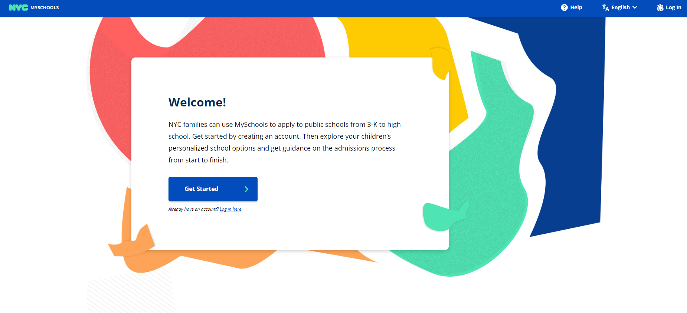
High School Application: Explore Schools and Programs
Learn about more than 700 programs at over 400 schools.
Explore programs online in MySchools (MySchools.nyc).
Use the printed 2020 NYC High School Admissions Guide for information about the application process and high school programs.
Choose 20 – 30 programs that interest you.
Narrow your list down to 12 program choices. Don’t list the Specialized High Schools on your application.
Notes:
Your child will officially start the application process in September, but right now it’s a great idea to start exploring schools and programs.
There are more than 700 high school programs in NYC, and over 400 different high schools across New York City.
You can explore schools and programs online in MySchools. This is a searchable, online version of the high school directory where you can find all detailed information about every school, and in the fall you’ll also submit your high school application online in MySchools in the same place.
You can also use the printed High School Admissions Guide for detailed information about the application process and high school programs.
Throughout the summer, find 20 – 30 programs that interest you, and then you’ll narrow this down to 12 choices in the fall.

Slide 16
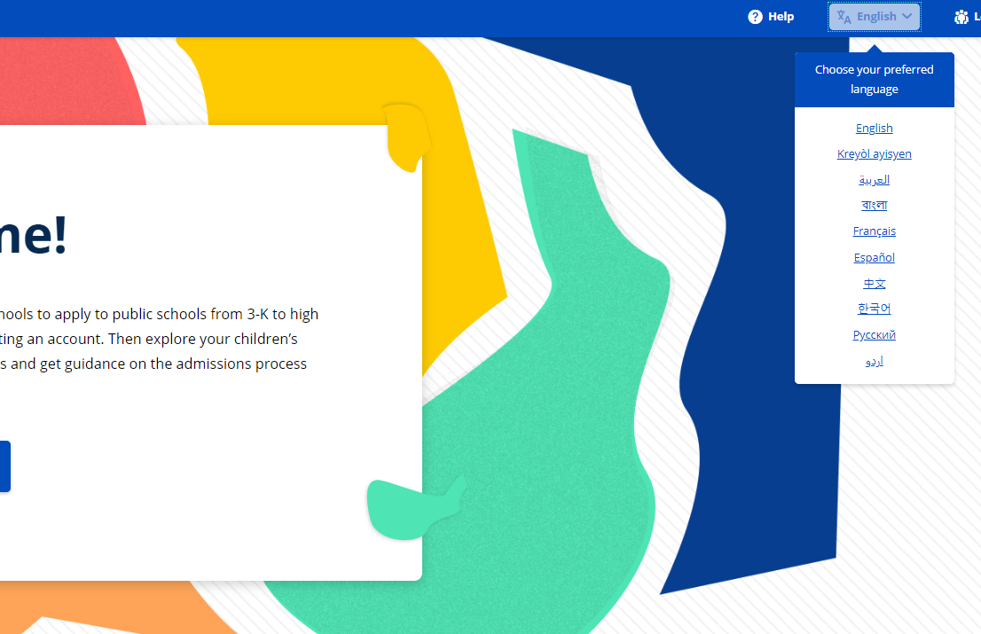
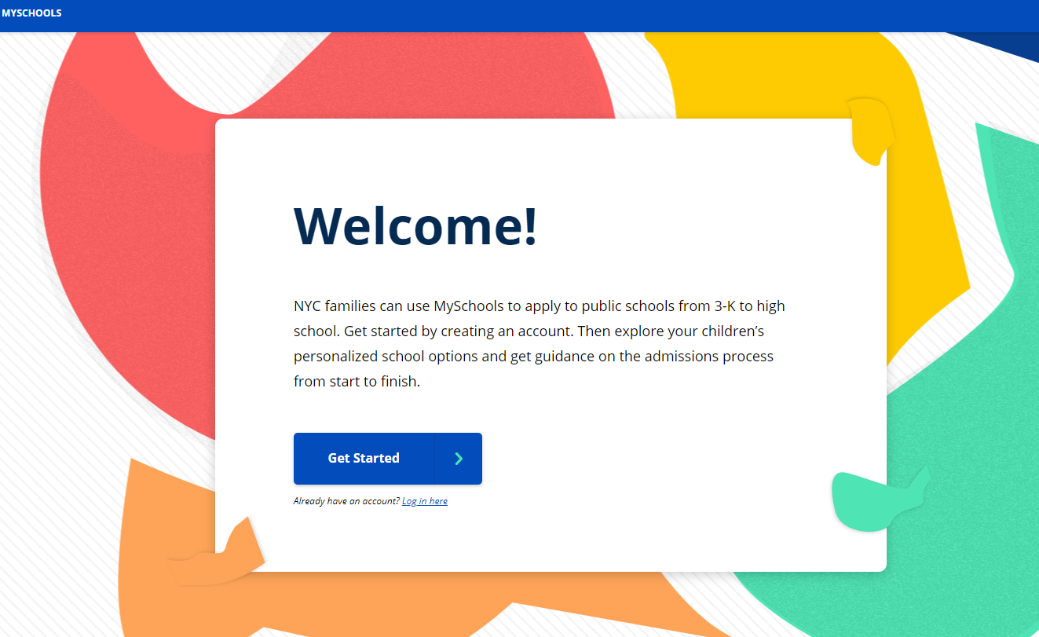
Explore Schools and Programs in MySchools
MySchools is the online high school directory and application
Go to myschools.nyc
Families can choose their preferred language.
Notes:
Let’s talk about how to explore schools and programs in MySchools.
MySchools is the online high school directory and application.
Go to the website myschools.nyc.
Families can choose their preferred language from the upper right hand corner, like this.

Slide 17
Explore Schools and Programs in MySchools
To view the searchable, online directory, go to myschools.nyc and scroll all the way to the bottom
Click on “Start Browsing”
Notes:
To start searching for schools, scroll all the way does to the very bottom of the page
Click on this button that says “Start browsing.”

Slide 18
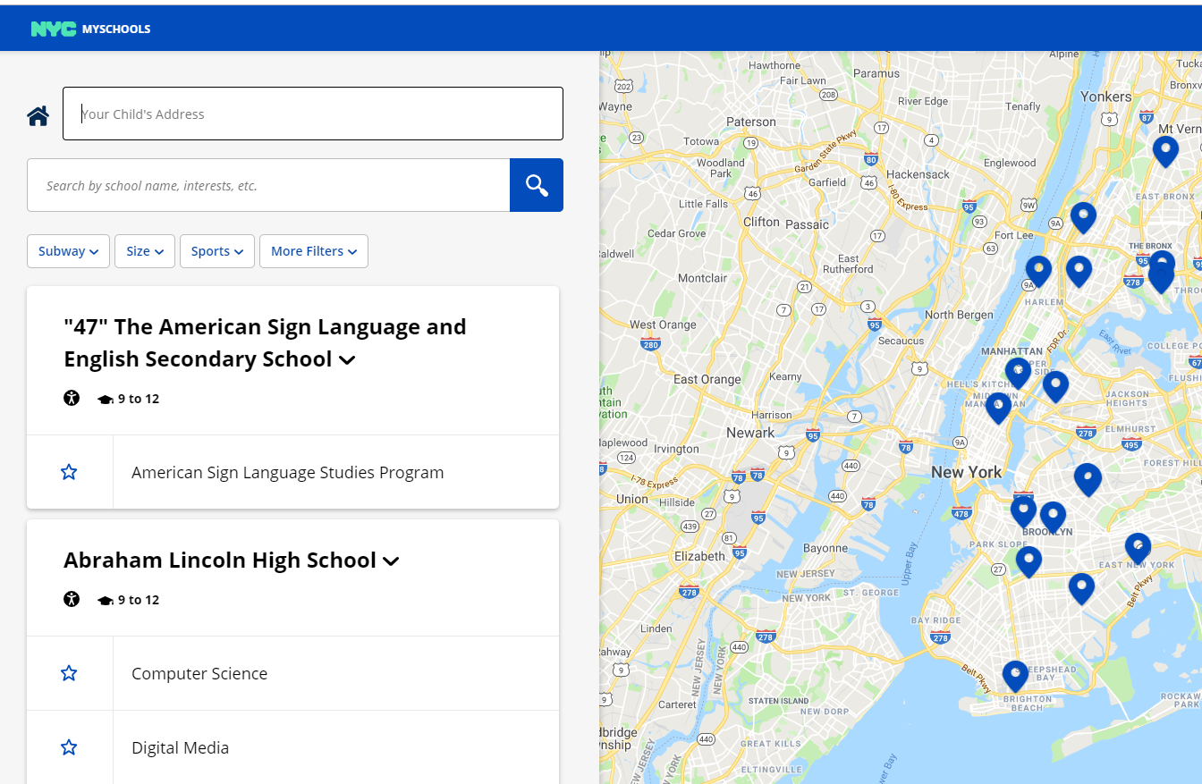
Explore Schools and Programs in MySchools
Use the search box.
Enter your child’s address to see schools near home.
Notes:
This is what the searchable directory looks like.
At the top, you can enter your home address. This will show you schools that are closer to home.
Right under that, there’s the search box. You can search for anything—the name of a school you want to learn more about, or you can search for things you want in a school, like “debate” or “robotics.”
Do your research now! Not after you submit your application. Now you have time to figure out if a school is a good fit and if your child can manage the commute.

Slide 19
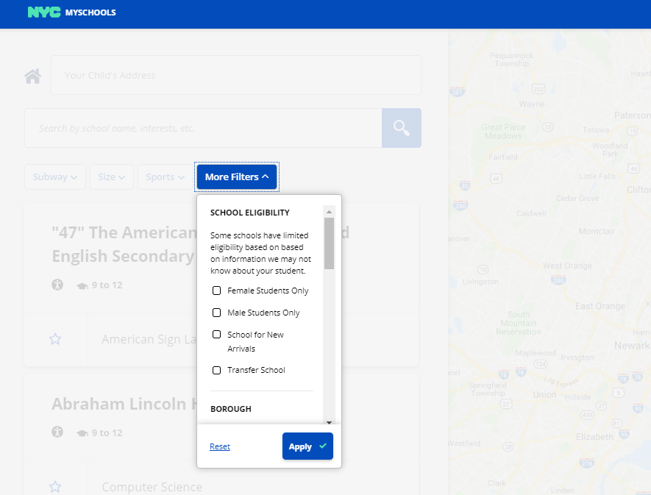
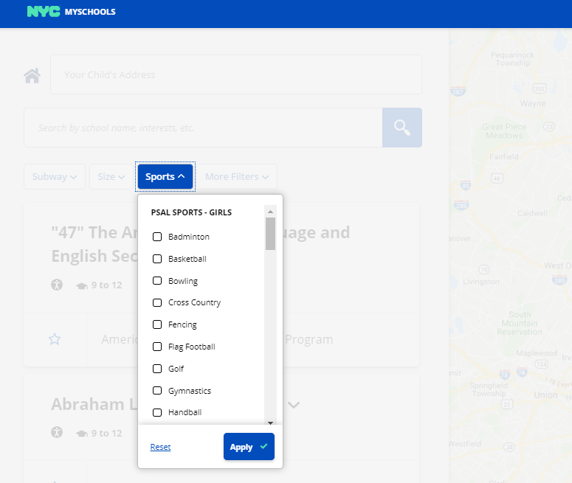
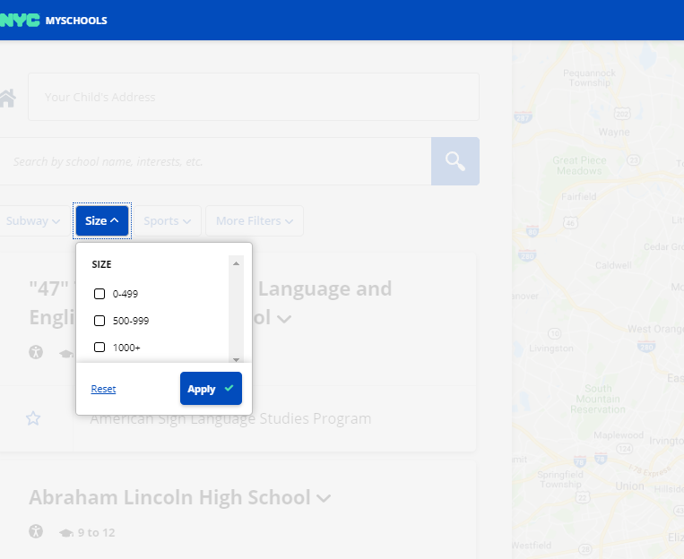
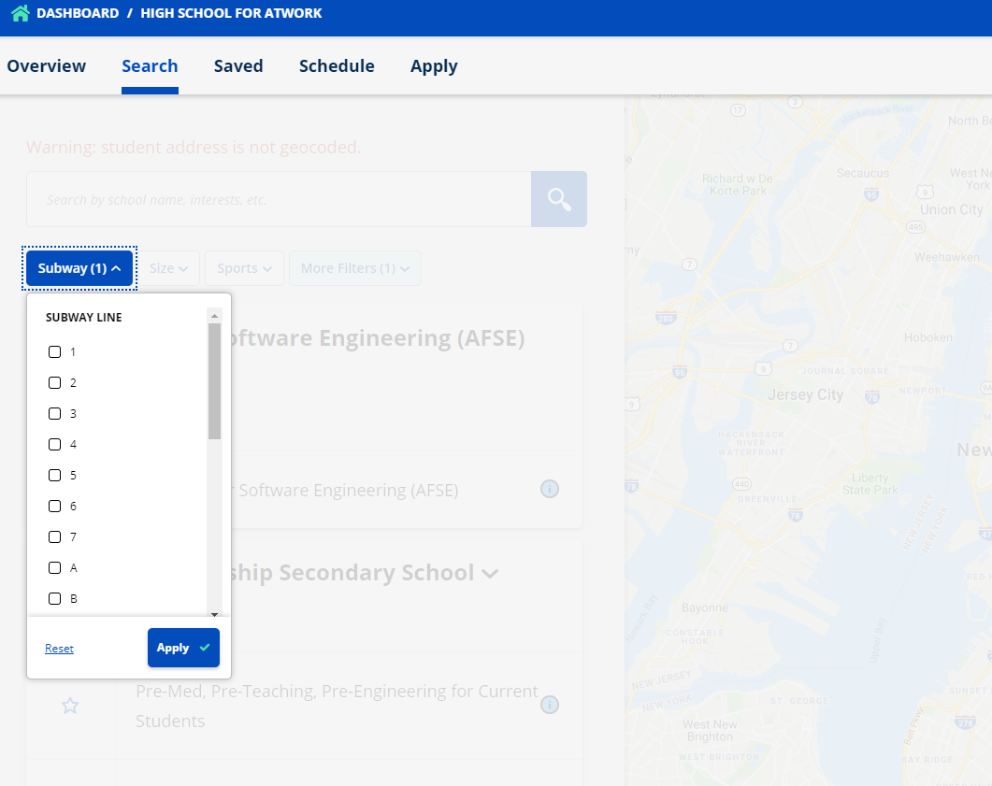
Narrow your search
Subway
Size
Sports
More Filters
Notes:
You can also narrow your search with some button you see here.
Click the Subway button to choose subway lines. This will show you only schools near the subway lines you chose.
Click the Size button to choose your desired school size.
Click Sports and choose the sports your child wants. This will show you only schools that offer those sports.
Click on More Filters to explore other options. From here you can choose to see:
Only schools in a certain borough
Single-gender schools
Schools that require a uniform
Only accessible schools
And other things
There’s more information in the High School Admissions Guide about this starting on page 10.

Slide 20
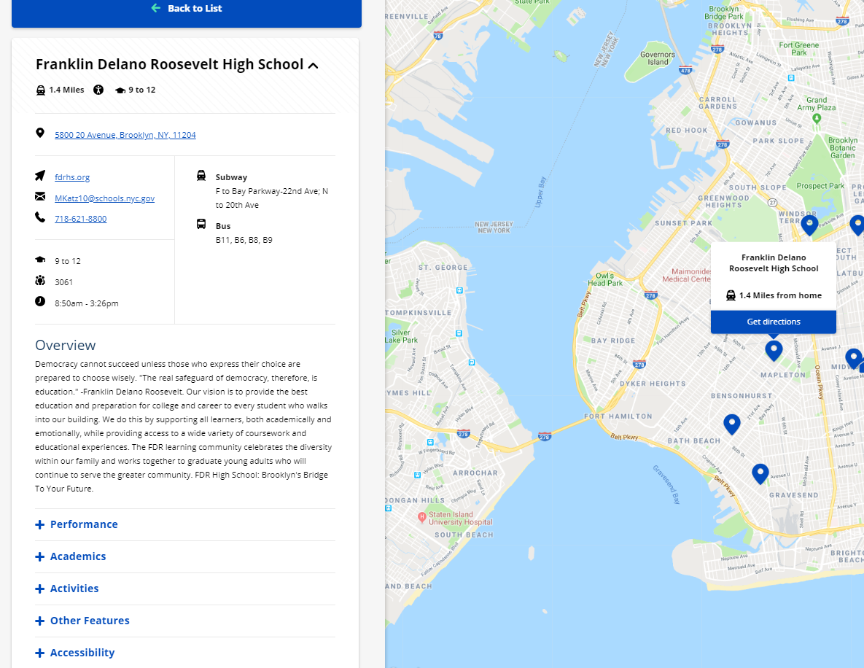
Learn about Schools
Map shows school and home
Click the name of a school to read more about it.
Location
Size and Schedule
School Performance
Academics
Activities
Other features
Accessibility
Notes:
To read more about a school, just click the name of a school. Then you’ll see this, the school page.
On the left is all the information about the school, and on the right is the map showing where the school is located.
You can read all about the school here. You can see:
Location
The size of the school, and the schedule
There’s the overview description of the school here.
You can see school performance by clicking there, which will show graduation rate and other metrics.
Activities shows extracurricular activities and clubs
Other features shows a lot of different things for schools.
And accessibility shows the school’s accessibility designation.
Right below this, you can see the programs at the school.

Slide 21
Types of Schools to Consider
Performing and Visual Arts
Career and Technical Education
Schools for newly-arrived students who are learning English
Performance Assessment Schools
Early College
Schools with grades 9 – 14
Community Schools
Notes:
Before we talk about programs, think about all the different types of schools there are in New York City.
This is just a partial list.
Information about these school types is in the High School Admissions Guide on pages 5 – 9.

Slide 22
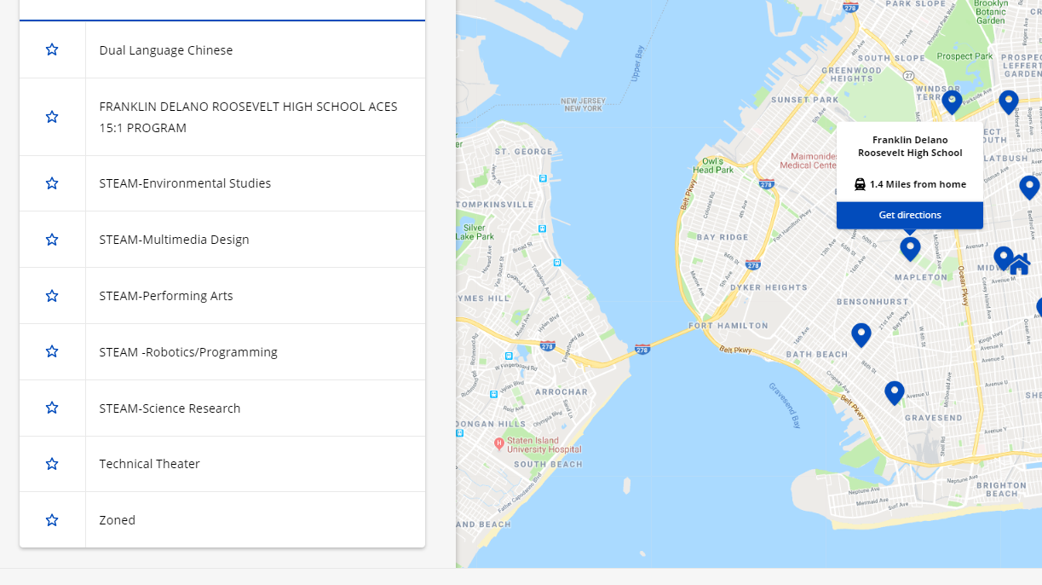
Learn about Programs
Like “doorways” to get into the school.
List programs on the high school application.
Programs at this school
Notes:
When you scroll down on the school page in MySchools, you’ll see programs at the school.
Think of programs like doorways to get into the school through the application process.
When you complete your application in the fall, you will list programs on the application, not schools.
Some schools have one program. Some schools have many programs. Each program is a choice on your application.
Click on the name of a program to read more about the program.

Slide 23
Learn More about Programs
Program name and description
Notes:
Program name and description: read about the program to decide if it has what you want.
Eligibility: shows who can apply
Admissions Method: shows what students need to do to be considered for the program. This section also shows information needed to determine your child’s chances of getting an offer.
Additional Information: shows the program’s interest area, and if there are 10th grade seats available

Slide 24
Program Factors that Affect Your Chances of Getting an Offer
Example program:
Demand last year: More applicants per seat means a lower chance of getting an offer.
Notes:
In the admissions method section of the page, you’ll see a lot of important information that will help you figure out your child’s chances of getting an offer to each program.
Admissions Methods show what students need to do to be considered for the program. We’ll talk about this more soon.
Priority Groups show the order in which applicants are considered for offers. Priority groups are different at different programs, and some programs don’t have these at all. Read this section to determine which priority group your child is in for each program. Remember, there is no sibling priority in High School Admissions.
Demand last year: this section shows the number of applicants and the number of seats show demand, or how popular a program was last year. More applicants per seat means a lower chance of getting an offer.

Slide 25
Program Factor: Admissions Methods
Shows what a student needs to do to be considered for admissions.
Programs that do not see an applicant’s school record:
Program that do see an applicant’s school record:
Open
Screened for language
Zoned
Test (SHSAT)
Screened
Audition
Educational Option (Ed. Opt.)
Notes:
Admissions Methods show what you need to do to get into each program.
These are on page 25 of the High School Admissions Guide. We’re not going to explain each one of these in detail right now, but make sure you take 10 minutes after this to read page 25. This is your 10 minute homework assignment.
I’m sure you have questions about your child’s academic record from the previous year, which is academics and attendance from 7th grade.
Programs with the admissions methods on the left [green] cannot see an applicant's school record, and the student’s previous year academic record is not used for admissions to these programs.
The three admissions methods on the right DO look at an applicant’s school record [blue].
A student’s academic record consists of core course grades (ELA, math, science, social studies), state test scores, and attendance from the previous year.

Slide 26
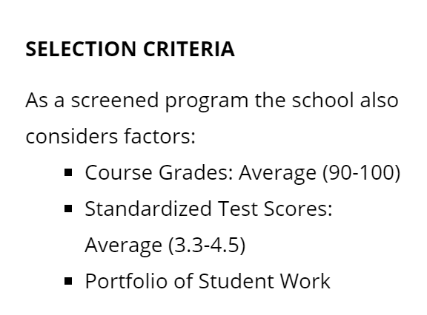
Programs with Screened and Audition Admissions Methods
School staff evaluate and rank applicants for admission.
Selection Criteria show the information used to evaluate applicants for admission.
The ranges show how a student compares to other applicants.
Example:
Audition programs: link to see audition dates starting in September.
Notes:
Let’s talk more about programs with screened and audition admissions methods.
For these programs, high school staff evaluate applicants for admission to these programs, and assign a ranking to applicants based on that evaluation.
Selection criteria show the information that high school staff use to evaluate applicants for admission. Different programs use different criteria, and the criteria for each program is listed in the high school directory.
Here’s an example of a program from MySchools. This program looks at course grades, standardized test scores, and a portfolio of student work.
Some programs require students to take additional action, such as auditioning, submitting a portfolio, interviewing, or taking an exam.
The ranges next to the selection criteria are the academic ranges of students who received an offer last year. This shows how a student compares to other applicants. These are competitive, selective programs.
For audition programs, starting in September, there will be a link to see audition dates for each audition program in MySchools.
There’s a video online that helps explain these programs! (this is available at schools.nyc.gov/High)

Slide 27
Determining Eligibility
Before listing a school on your application, make sure you are eligible for the school.
Example–
Eagle Academy is all boys
Young Women’s Academy is all girls
Boys and Girls High School – Only open to Brooklyn Residents
Academy for Language & Technology – Only open to ENL students

Slide 28
What makes a balanced application?
12 programs
Not just high-demand programs
Mix of admissions methods
Your child is in the first priority group for some programs
Only apply to programs that you want your child to attend
Notes:
Remember, your goals is to build a balanced application in the fall. And this is what we mean:
12 programs: Your child’s application has 12 program choices that you want.
Not just high-demand programs: These programs have many more applicants than available seats. More applicants per seat means a lower chance of getting an offer. If you apply to any high-demand programs (10 or more applicants per seat), find some programs that have fewer than 10 applicants per seat.
Mix of admissions methods: Your child’s application has a mix of admissions methods. If you’re going to apply to any screened or audition programs, find some programs that use the Educational Option and Open admissions methods.
Your child is in the first priority group for at least some programs: Not in the first priority group means a lower chance of getting an offer.
Make sure you only apply to programs that you want your child to attend.

Slide 29
Program Choices on the Application
98% of students who listed 12 programs received an offer to a choice on their application.
Listing 12 programs means you will have a better chance of getting an offer from one of your choices.
Notes:
A very important student factor is the number of choices on the Application
98% of students who listed 12 programs on their Applications received an offer in Round 1 last year. If you list 12 programs on your application, you will have a better chance of getting an offer from one of your choices.
Make sure you apply to 12 programs that you want your child to attend.

Slide 30
Program Choices on the Application
List programs in your true order of preference, starting with your top choice.
High schools cannot see the order of programs on your child’s application.
Students are considered for offers in the order of the programs on their application.
If you don’t get into your first choice, then you are considered for the next choice. It’s as though the next choice is your new first choice.
Notes:
One of the most important things is the order of choices on your application.
High schools cannot see the order of programs on your child’s application. The matching process is done centrally.
Students are considered for offers in the order of the programs on their application.
If your child doesn’t get into their first choice, then they are considered for the next choice, and it’s as though the next choice is their new first choice. Your child is not at a disadvantage for their next choice at all at this point.
Also, if your child does get into their first choice, then that’s it! They’re not considered for any of the other choices on their application. So your first choice should be your real first choice, even if it’s a competitive program.

Slide 31
Getting an Offer
Required
Two paths for students
Optional
High School Application 700+ Programs at 400+ High Schools
Specialized High Schools 8 Testing Schools LaGuardia HS
Early Fall
Start your High School Application
Register—then get Test or Audition Ticket.
Group Three
Complete application by listing 12 programs in your true order of preference.
Take SHSAT
Audition
Late Fall
March
Up to 1 Offer
1 Offer
1-6 Offers
Notes:
In March, you’ll get an offer letter. This will show the results of your application AND the results from the specialized high school process (if your child did this).
Your child can get up to one offer from the high school application.
Most students get an offer to a program from their application.
A small percentage of students do not get an offer to one of the choices on their application. If this happens to your child, that means that they were considered for all the programs on the application and it was not possible to get an offer to one of them.
If you don’t get an offer from your high school application and you don’t get an offer to a Specialized High School, then you will get an offer to a high school that wasn’t on your application. This is why we recommend a balanced application with 12 choices! In this case, the Office of Student Enrollment will find a school close to home that has availability.

Slide 32
Offer Letters in March
Results from the high school application
Results from the SHSAT and LaGuardia auditions (if applicable)
A list of programs where your child is waitlisted. Your child will automatically be added to the waitlist for any program you listed higher on the application than the program where you received an offer.

Slide 33
Waitlists—what will change and what won’t?
What is staying the same?
The high school application will remain the same:
Opens in early October.
12 choices in preference order.
Offer letters in March.
What will be different?
No Round 2 application.
Instead, all programs will have waitlists. Waitlists will open in March immediately after offer letters.
Specialized High Schools will NOT have waitlists, just like they did not have Round 2 or Appeals in the past.

Slide 34
Waitlists: Spring and Summer
Students will be placed on waitlists for all programs listed higher on their application than the offer program.
A student’s position on the waitlist is determined by each school’s priority groups and within the priority groups, the student’s number for that program (random number for programs that don’t rank applicants, rank number for screened and audition programs).
If and when a seat becomes available at a program with a waitlist, then it will be offered to the next student on the waitlist.
As soon as a seat becomes available at a program with a waitlist, the high school will contact the waitlisted student getting the offer. This may be any time after offers letters go out in March, throughout the spring or summer.
Families will be able to check their child’s position on any waitlist in MySchools.

Slide 35
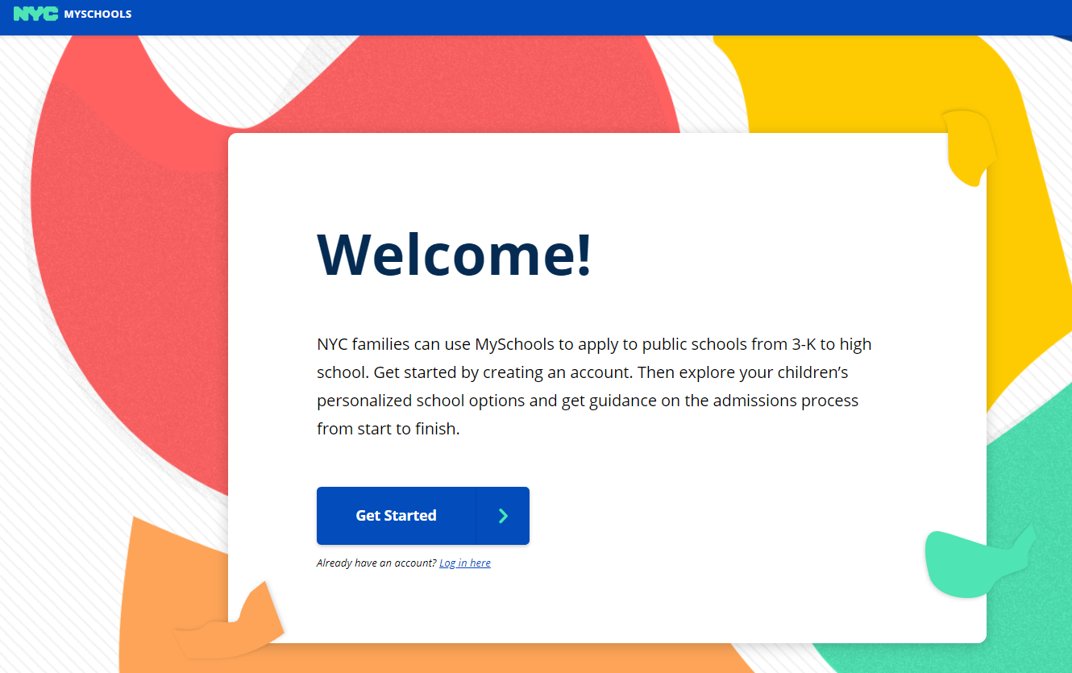
Create an Account in MySchools
Go to MySchools.nyc
Click on Get Started
Notes:
Counselors can share this with families in June, or in September. Families can do this in June, but they can’t start the application or register for SHSAT or LaGuardia until the fall. If you have families start this in June, make sure you tell them what they can and cannot do in June.
To create an account in MySchools, go to myschools.nyc.
Click on Get Started.

Slide 36
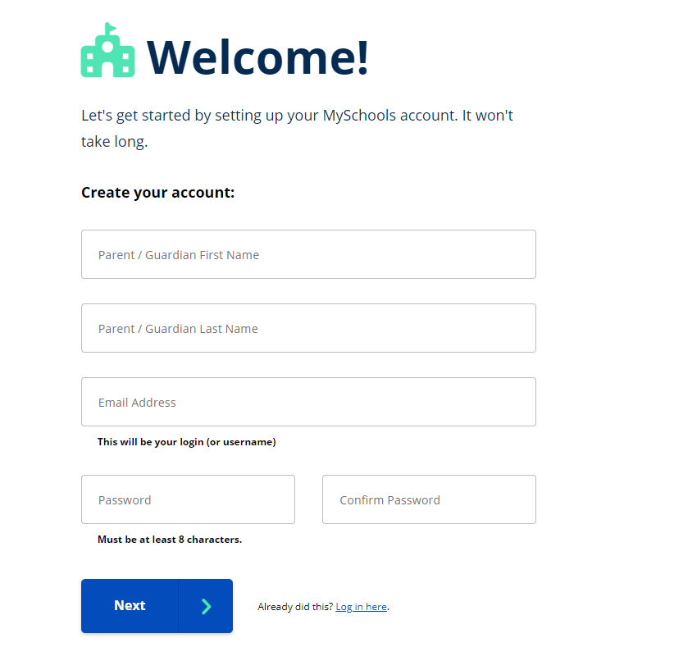
Create an Account in MySchools
Name
Email address
Choose your MySchools password.
Click Next
Notes:
Type your name
Type your email address
Choose your MySchools password. Type your password twice.
Click the Next button

Slide 37
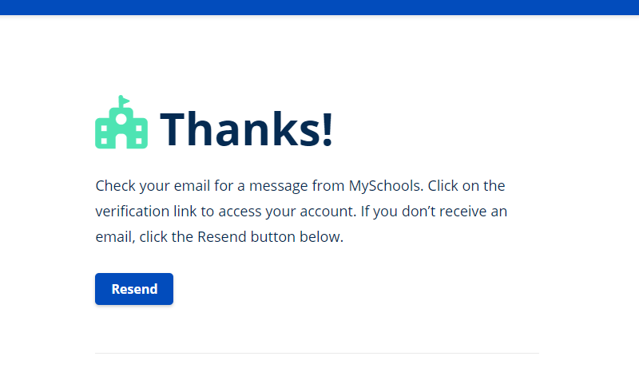
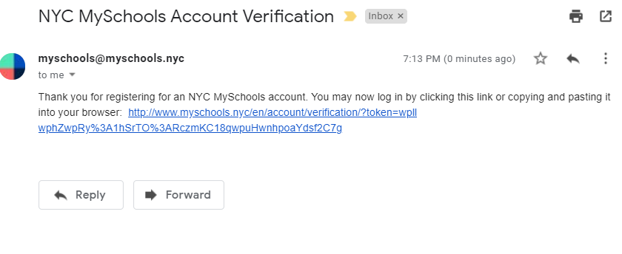
Create an Account in MySchools
Open the email
Click the link
Notes:
Next you see instructions to check your email.
This means MySchools sent you an email message. You must open that email message in order to continue. Log into your email account and open the email from MySchools. Click the link in that email. This will take you back to MySchools and you can finish creating an account.

Slide 38
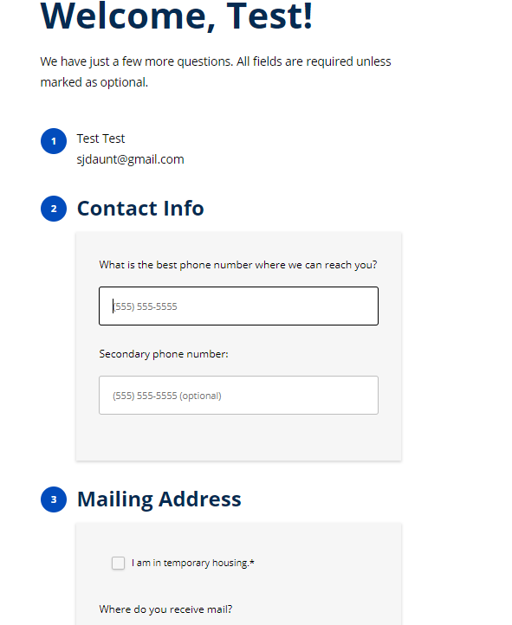
Create an Account in MySchools
Phone number
Mailing address in NYC
Preferred language
Click Submit
Notes:
Type your phone number
Type your mailing address. It must be a New York City address. Remember, students who do not live in New York City cannot participate in High School Admissions.
Choose your preferred language
Click the Submit button

Slide 39
Create an Account in MySchools
Add your child starting in September.
Notes:
When you see the Dashboard, you have finished creating an account in MySchools.
In September of your child’s 8th grade year, you’ll get a Welcome Letter. This letter includes information you need to add your child. After that, you can click on Add a child to add your child to your account.

Slide 40
Welcome Letters—September
Sent to your home address in early September.
Private or parochial school students—visit a Family Welcome Center.
Your Welcome Letter has:
Account creation code
Instructions for getting started in MySchools
Notes:
In September, the Office of Student Enrollment will send a printed Welcome Letter to each public school 8th grade student at their home address.
If you don’t get this letter in the mail, let me know and I can print one for you.
Students who attend a private or parochial school can get their letter from their current school counselor or at a Family Welcome Center.
Your Welcome Letter has:
Account creation code
Instructions for getting started in MySchools
After that, you can add your child in MySchools and start your application.

Slide 41
Add Your Child in MySchools
Click on
Add a child
You need your Welcome Letter
Notes:
Read notes only:
When you see the Dashboard, you have finished creating an account in MySchools.
In September of your child’s 8th grade year, you’ll get a Welcome Letter. Only after that you can click on Add a child to add your child to your account.

Slide 42
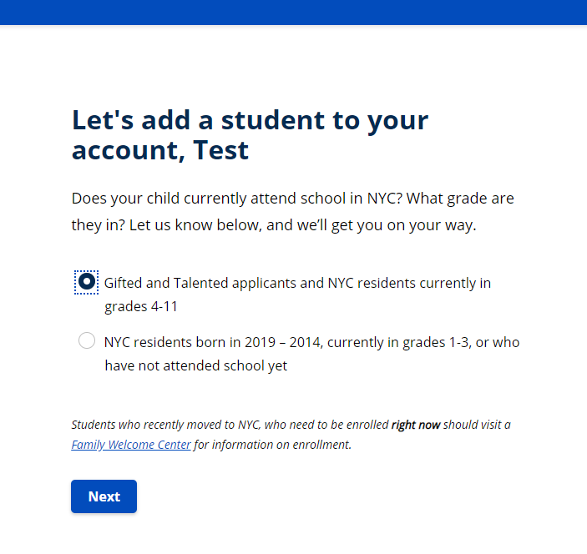
Add Your Child in MySchools
Choose grades 4 – 11
Notes:
Read notes only:
When you see the Dashboard, you have finished creating an account in MySchools.
In September of your child’s 8th grade year, you’ll get a Welcome Letter. Only after that you can click on Add a child to add your child to your account.

Slide 43
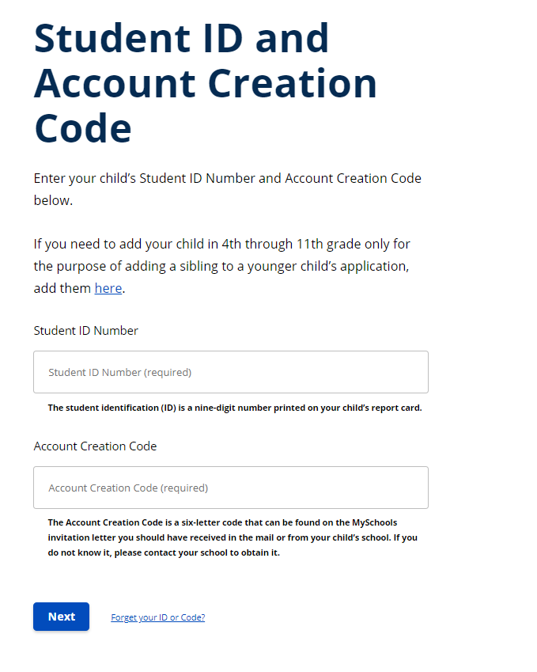
Add Your Child in MySchools
Student ID number:
9 numbers, no dashes or spaces
Account creation code (from the Welcome Letter): 6 capital letters, no dashes or spaces
Notes:
Read notes only:
When you see the Dashboard, you have finished creating an account in MySchools.
In September of your child’s 8th grade year, you’ll get a Welcome Letter. Only after that you can click on Add a child to add your child to your account.

Slide 44
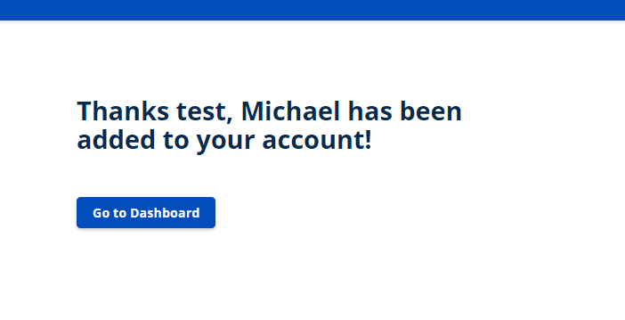
Add Your Child in MySchools
If it worked, you’ll see this.
If it didn’t work, you must go back and type your child’s ID number and account creation code correctly.
Notes:
Read notes only:
When you see the Dashboard, you have finished creating an account in MySchools.
In September of your child’s 8th grade year, you’ll get a Welcome Letter. Only after that you can click on Add a child to add your child to your account.

Slide 45
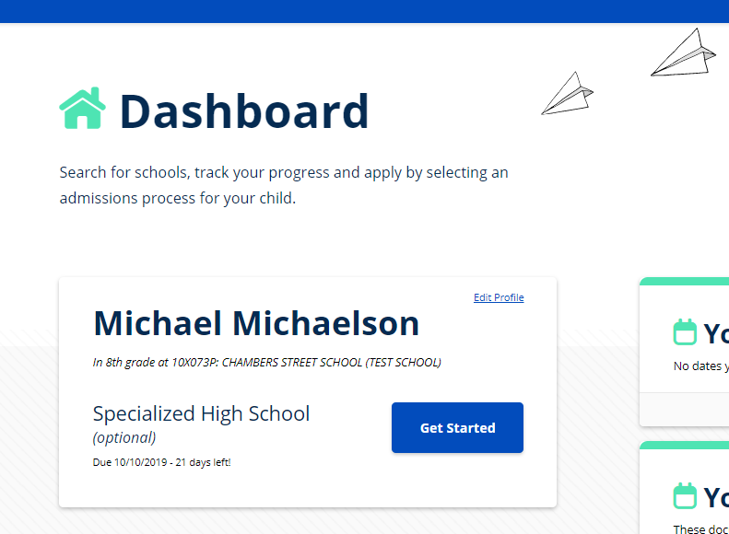
Add Your Child in MySchools
Your dashboard looks like this after you add your child.
To register for the Specialized High Schools testing and auditions, click on Get Started.
In early October, you can start your child’s High School Application from here.
Notes:
Read notes only:
When you see the Dashboard, you have finished creating an account in MySchools.
In September of your child’s 8th grade year, you’ll get a Welcome Letter. Only after that you can click on Add a child to add your child to your account.

Slide 46
Next Steps: October
Register for Specialized High Schools testing and auditions (optional)
Create an account in MySchools (MySchools.nyc) and add your child.
Register for the SHSAT and/or LaGuardia auditions in MySchools.
Explore Schools and Programs
Explore schools and programs in MySchools (MySchools.nyc).
Find 20 – 30 programs that interest you.
View helpful videos on | schools.nyc.gov/High
Look for Possible Virtual Open House Events
High School Events Calendar | schools.nyc.gov/High
Notes:
Read notes only:
In the early fall, you can create an account and add your child in MySchools. Then you can register for the SHSAT and LaGuardia auditions in MySchools.
You can attend more events in the fall. We have high school fairs in each borough in September and October. Our events calendar is online at schools.nyc.gov/high
Fall is also a good time to visit schools and go to any auditions or assessments for programs you’re interested in.

Slide 47
Next Steps: Late October & November
Start Your Child’s Application
Create an account in MySchools (MySchools.nyc) and add your child.
Search for programs, save them to your favorites in MySchools
Start your application in MySchools
Attend Virtual Open House Events
High School Events Calendar | schools.nyc.gov/High
Notes:
Read notes only:
In the early fall, you can create an account and add your child in MySchools. Then you can register for the SHSAT and LaGuardia auditions in MySchools.
You can attend more events in the fall. We have high school fairs in each borough in September and October. Our events calendar is online at schools.nyc.gov/high
Fall is also a good time to visit schools and go to any auditions or assessments for programs you’re interested in.

Slide 48
Next Steps: November and December
Take the SHSAT and/or audition for LaGuardia High School (optional)
Complete auditions or program-specific assessments for any programs your child will be applying to.
Submit your child’s high school application in MySchools (MySchools.nyc) by December 4th
Notes:
Read notes only:
In the late fall, students take the SHSAT and audition for LaGuardia.
You’ll also complete any other auditions or assessments for programs your child will apply to.
And you’ll submit your child’s application in MySchools by December . There’s no advantage to submitting it early, and you can change your application at any time up until the deadline.

Slide 49
Resources
High School events calendar, videos, and more | schools.nyc.gov/High
MySchools directory and application | MySchools.nyc
High School Admissions Email List | schools.nyc.gov/Connect
Call the Office of Student Enrollment | 718-935-2009
Contact Mrs. Dante by email at ndante@schools.nyc.gov
schools.nyc.gov/High
Notes:
Here are resources for you to use.
The website for our videos, the calendar, and more information is schools.nyc.gov/High
MySchools is at myschools.nyc.
You can sign up for emails at schools.nyc.gov/Connect.
You can call the Office of Student Enrollment at 718-935-2009.
Thank you for being here today! I look forward to working with you and your child to successfully apply to high school! Please feel free to reach out to me at any time. Here is my contact information.

Slide 50
Questions
Please email me directly at Ndante@schools.nyc.gov.

